Slide 1


Consumer Loan Assistant Project
Internship At
Suven Consultants & Technology Pvt. Ltd.
Done by
Yash Joshi (18IT442)
Information Technology Department
Birla Vishvakarma Mahavidyalaya Engineering College
(An Autonomous Institution)
AY: 2020-21

Slide 2
Abstract :
Projects : Consumer Loan Assistant Project
Language & Technology used : java using VScode
Duration : 4 weeks

Slide 3

1. Consumer Loan Assistant Project

Slide 4
AIM :
To get loan analysis from online.
Scop :
Loan management system has been designed to online the back-office activities of bank and finance company which offers any type of loan.
Administrator manage customer information database more efficiently, Loan details, maintain loan type and interest rate information.
Admin can use calculator to give exact payable loan amount forth customer & generate all these work info as a report of each customer.

Slide 5
Implementation :
Input
Output
Loan Balance
Interest Rate
No. of Payments / Monthly Payment
No. of Payment/
Monthly Payment
Loan Analysis

Slide 6
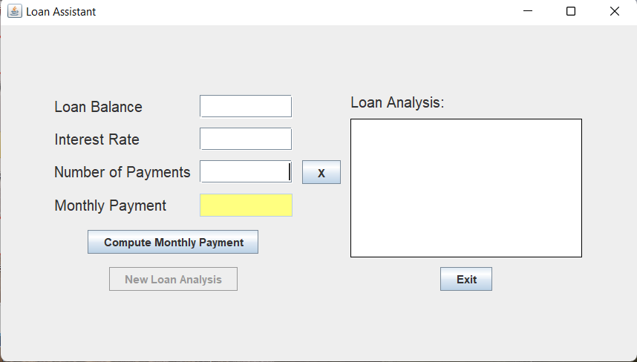
Output :
( Resultant output )

Slide 7
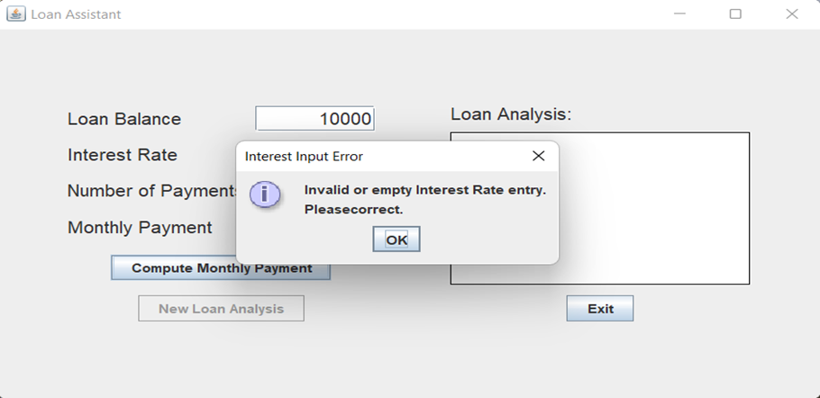
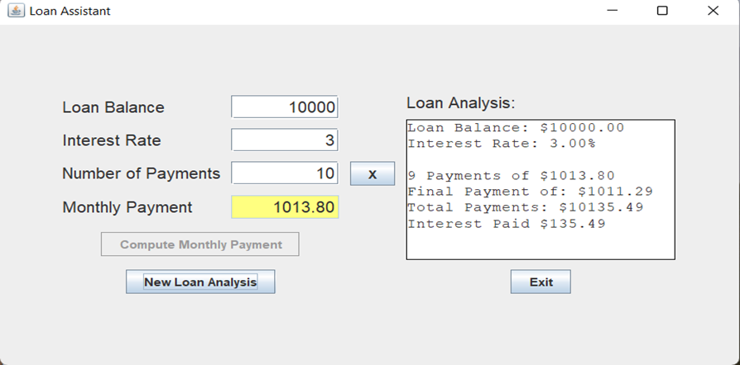
( Error caused in form )
(Loan analysis from input )

Slide 8
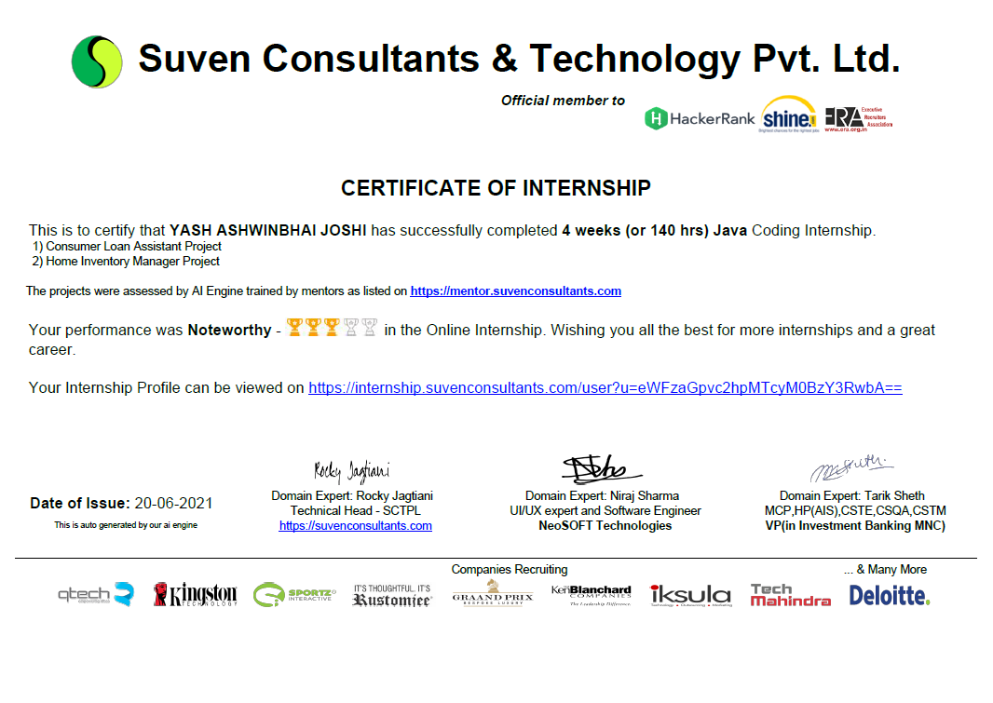
Certificate :

Slide 9
Thank You

